Slide 1


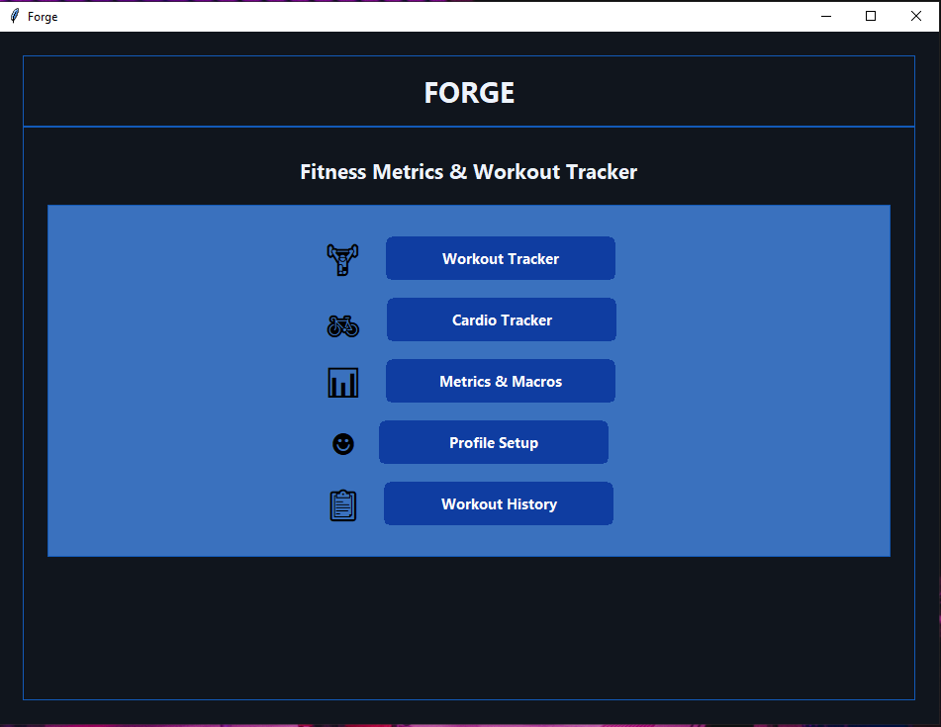
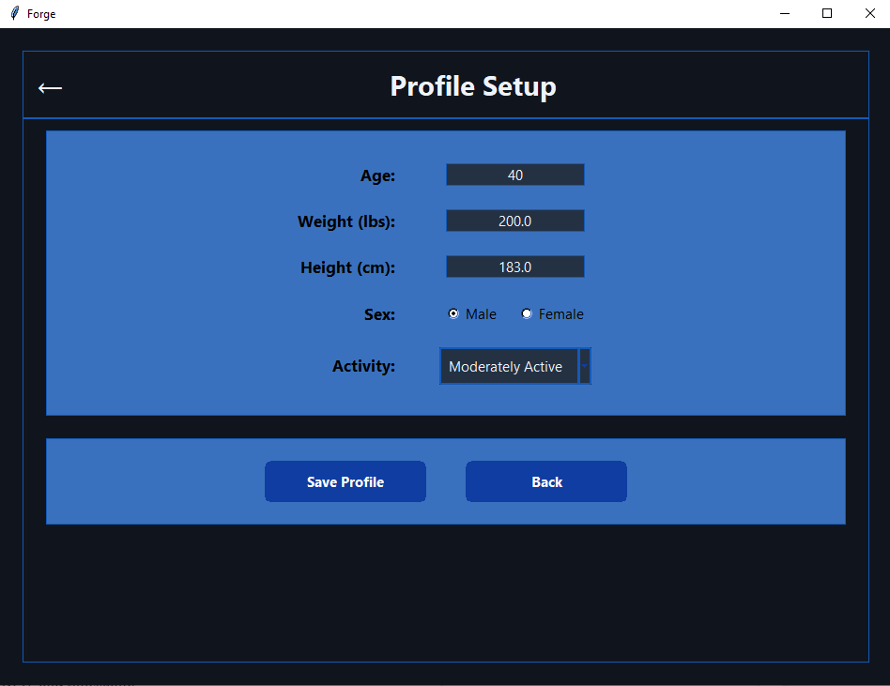
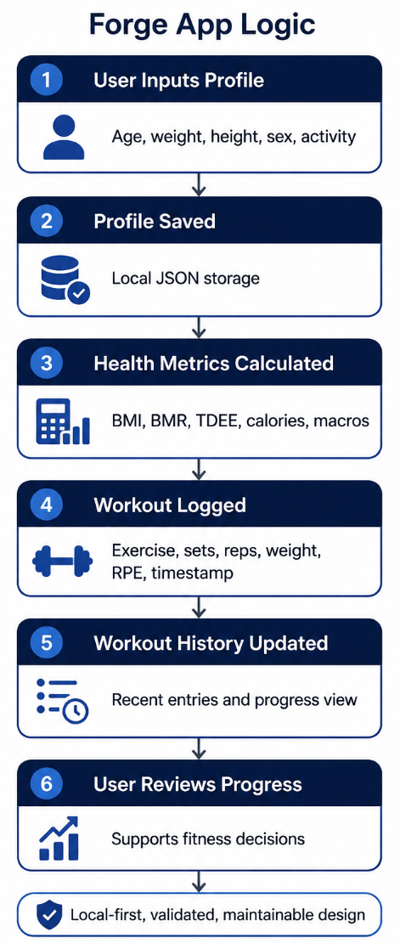
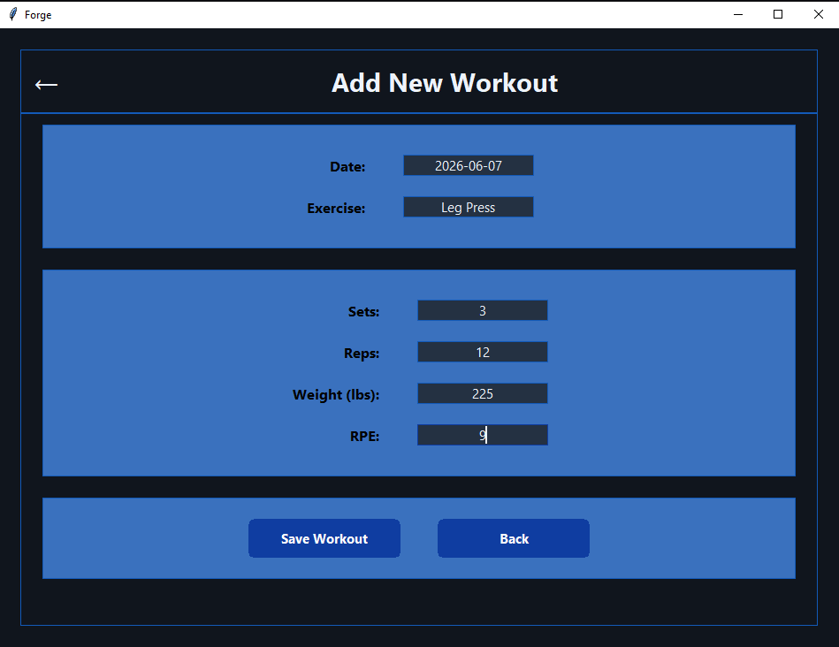
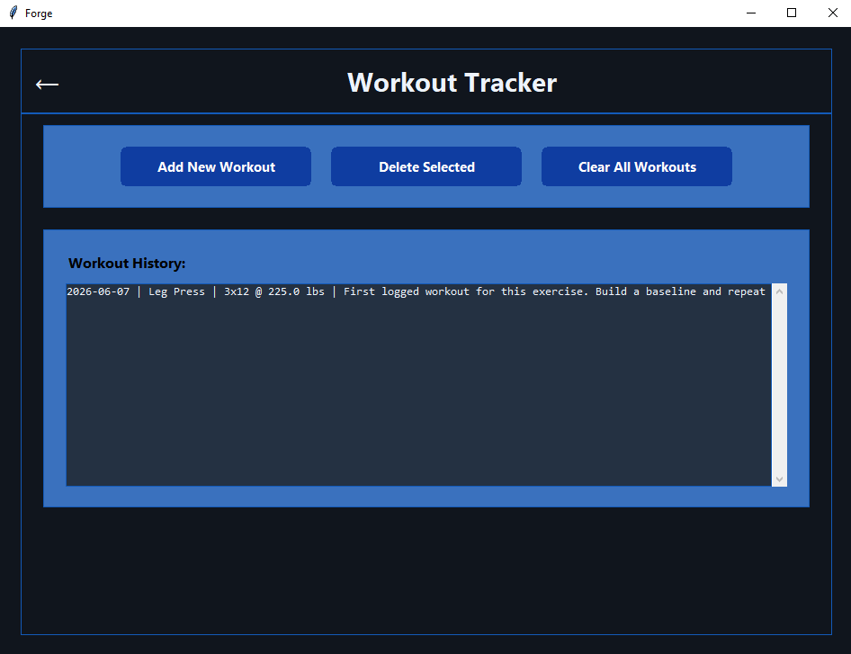
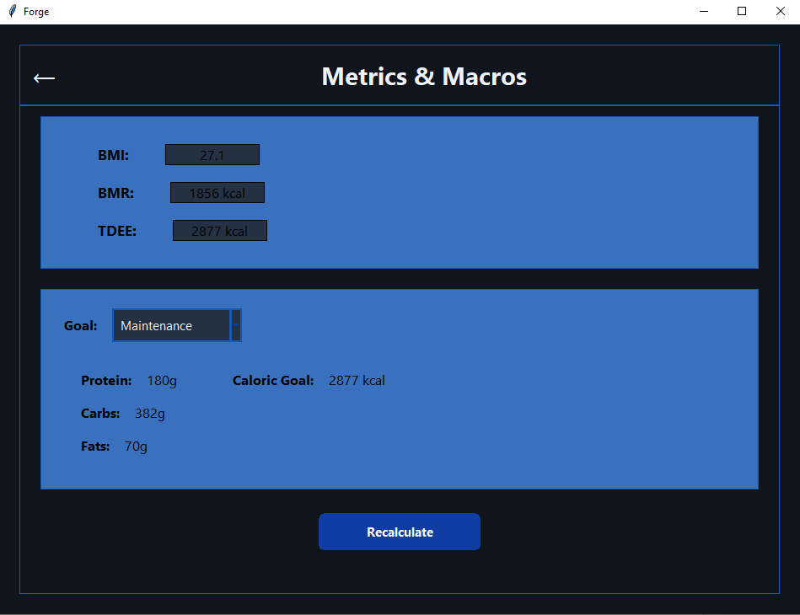
FORGE
Yaroslav Morozov – YMorozov@my.gcu.edu | Grand Canyon University | CST-452 Technology Showcase Poster
Local-First Fitness Tracking Application
A focused desktop tool for fitness profile setup, target calculation, workout logging, and progress review.
1. Project Description
Forge is a local-first desktop fitness application designed to keep personal fitness planning simple and useful.
Users create a profile and calculate baseline targets.
Workout sessions are logged with enough detail to review progress over time.
The workflow is intentionally narrow: plan, log, review, and adjust.
The project avoids cloud accounts, ads, and social features so the user can focus on training data instead of app noise.
2. Project Justification Many fitness apps become bloated with subscriptions, feeds, and features that do not help the user make the next training decision.
Local data storage supports privacy and offline use.
Simple navigation reduces friction for repeated logging.
Progress review supports progressive overload and better training consistency.
Forge was built as a practical, focused tool rather than a large social fitness platform.
Screenshot / Visual Evidence
3. Functional Requirements, Product Specifications, and Standards
Functional Requirements
Create and edit a user fitness profile.
Calculate BMI, BMR, TDEE, calorie targets, and macro targets from user inputs.
Log workouts with exercise name, sets, reps, weight, RPE, and timestamp.
Display workout history and compare recent entries to support progress decisions.
Validate inputs and provide clear error messages.
Product Specifications / Standards
Python desktop application with a Tkinter graphical user interface.
Local JSON persistence for profile and workout data.
Modular code organization for maintainability, testing, and future expansion.
Local-first privacy, reliable save/load behavior, and clear user flow.
4. Design Process Overview
The project followed an iterative process that moved from scope definition to implementation, then into testing and polish.
Defined the core user problem and limited scope to profile, calculations, logging, and review.
Mapped the main user flow before implementation: profile setup -> dashboard -> workout log -> history.
Separated responsibilities across UI, calculation logic, data models, and storage.
Built core features first, then refined validation, navigation, and data handling.
Reviewed the final application from both a technical and user perspective.
5. Relevant Data Summaries
User / Profile Data Height, weight, age, biological sex, activity level, and goal.
Calculated Fitness Metrics BMI, BMR, TDEE, calorie target, and macro targets.
Workout Data Exercise, sets, reps, weight, RPE, timestamp, and history
entries.
Testing Summary Core user stories verified through manual system testing. Calculation outputs checked against expected formulas. Profile save/load and workout history reviewed through integration-style testing.

